Slide 1

What is AI? (Artificial Intelligence)
Andela-Professional Skills
JP Tuyikunde
December 2021

Slide 2
Contents
What do people think of AI
What is really AI
History of AI
Types of AI
Disciplines of AI
Applications of AI
Conclusion

Slide 3
Elon Musk:
I think the danger of AI is much greater than the danger of nuclear warheads by a lot… mark my words: AI is far more dangerous than nukes
What do people think of AI?
Mark Zuckerberg:
I think that AI is going to unlock a huge amount of positive things, whether that's helping to identify and cure diseases, to help cars drive more safely, to help keep our communities safe.
Jeff Bezos:
I think autonomous weapons are extremely scary

Slide 4
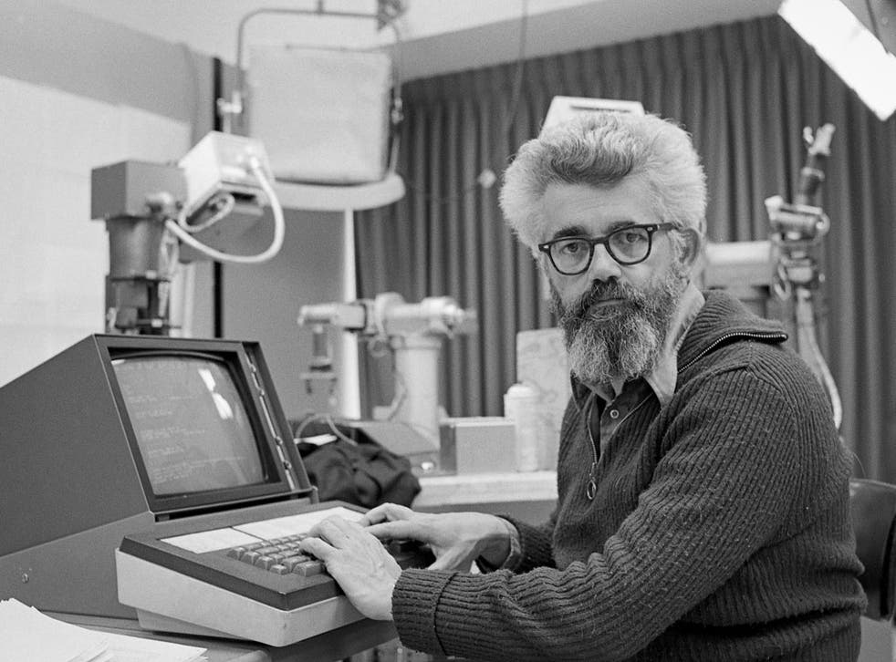
John McCarthy (AI Founder):
What is really AI?
It is the science and engineering of making intelligent machines, especially intelligent computer programs…
At its simplest form, artificial intelligence is a field, which combines computer science and robust datasets, to enable problem-solving.

Slide 5
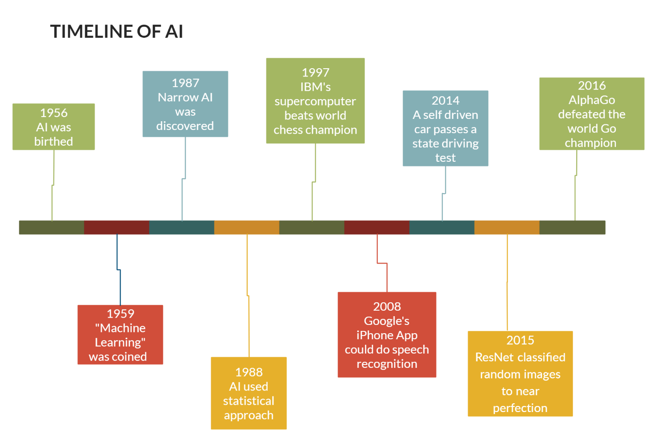
History of AI?

Slide 6
Types of AI
Weak AI or Narrow AI:
is AI trained and focused to perform specific tasks. Weak AI drives most of the AI that surrounds us today.
Ex:
Apple’s Siri
Amazon's Alexa
IBM Watson
Autonomous vehicles.
Strong AI
is a theoretical form of AI where a machine would have an intelligence equaled to humans; having a self-aware consciousness that has the ability to solve problems, learn, and plan for the future.(from science fiction).
Ex:
Person of Interest (TV series)
Legends of Tomorrow (Guardian)
A Space Odyssey.(Rogue assistant)

Slide 7
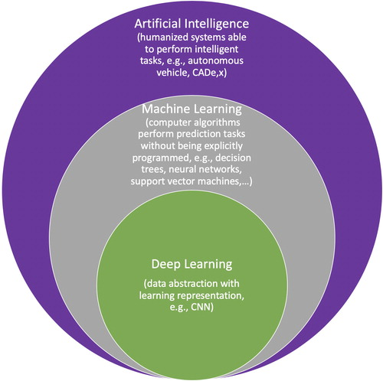
Disciplines of AI
Deep learning and machine learning tend to be used interchangeably, it’s worth noting the nuances between the two.
MACHINE LEARNING is more dependent on human intervention to learn.
DEEP LEARNING automates much of the feature extraction piece of the process, eliminating some of the manual human intervention required and enabling the use of larger data sets.

Slide 8


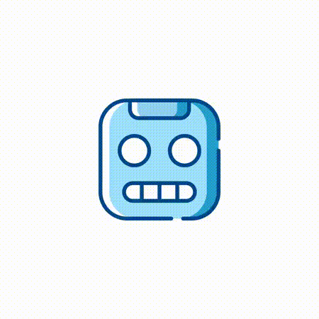
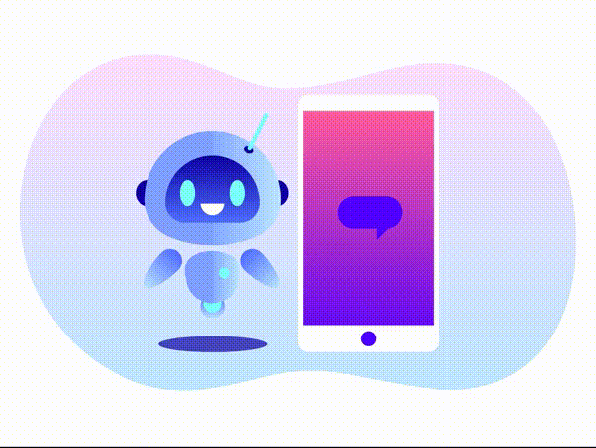
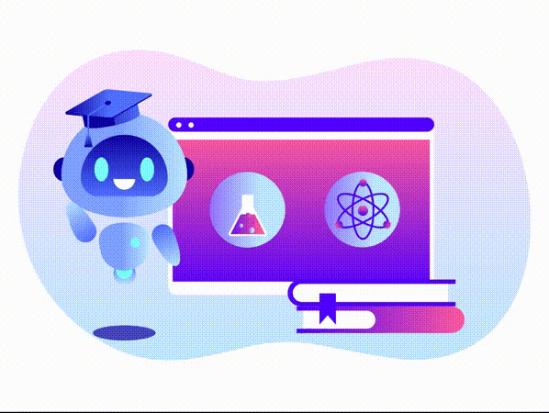
There are numerous, real-world applications of AI systems today. Below are some of the most common examples:
Automated stock Trading
Application of AI
Computer Vision
Healthcare
Customer service
Education

Slide 9
Artificial intelligence is a field, which combines computer science and robust datasets, to enable problem-solving.
It also encompasses sub-fields of machine learning and deep learning, which are frequently mentioned in conjunction with artificial intelligence.
These disciplines are comprised of AI algorithms which seek to create expert systems which make predictions or classifications based on input data.
Today AI is impacting different sectors and improving people’s lives.
However, we have to be mindful of the danger of AI.
Conclusion

Slide 10
https://www.ibm.com/cloud/learn/what-is-artificial-intelligence
https://www.sas.com/en_us/insights/analytics.html
https://whatis.techtarget.com/glossary/Algorithms
https://interestingengineering.com/tech-leaders-have-strong-opinions-on-artificial-intelligence
https://iconscout.com/ (For animations)
References

Slide 11
Thank You.

